Slide 1
Process
Filter is applied to the sensor data
SVD is applied to the sensor data (in the time domain)
Extract a segment of e.g. 512 samples across each of the 8 sensors
Perform a SVD matrix factorization
Plot Singular Values
In this case, only the SVD singular values are of interest, so there are no waterfall plots for the filters

Slide 2
BP Filter Parameters
Waterfall Plots
Constants
BW: 1/10
Decimation: 9
F_{ord}: 80
F_{ctr} moves through the range 0, 1/10, 2/10, 3/10, 4/10, 5/10, 6/10, 7/10, 8/10, 9/10
Waterfall plot of Sensor 1 of Snippet 4
Unprocessed data
The black box is where SOI is located
Added because SOI is difficult to see

Slide 3
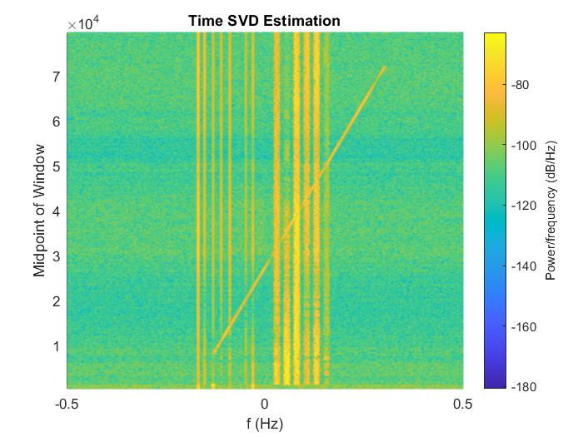
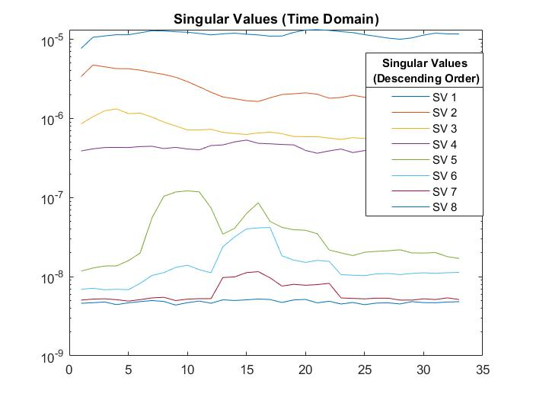
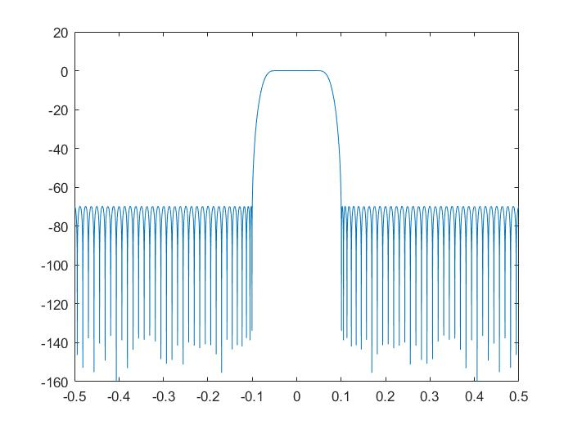
Filter 1
SOI

Slide 4
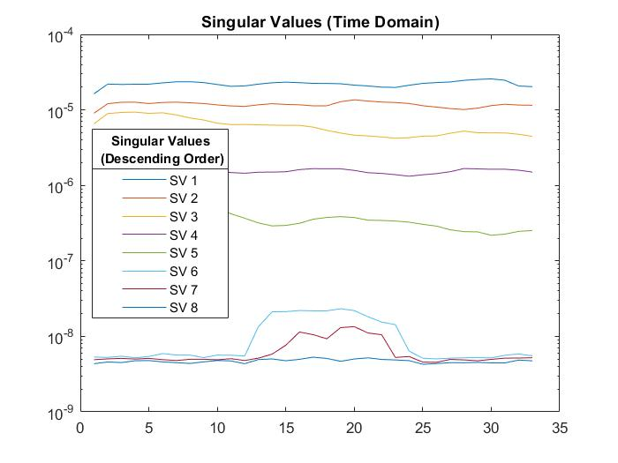
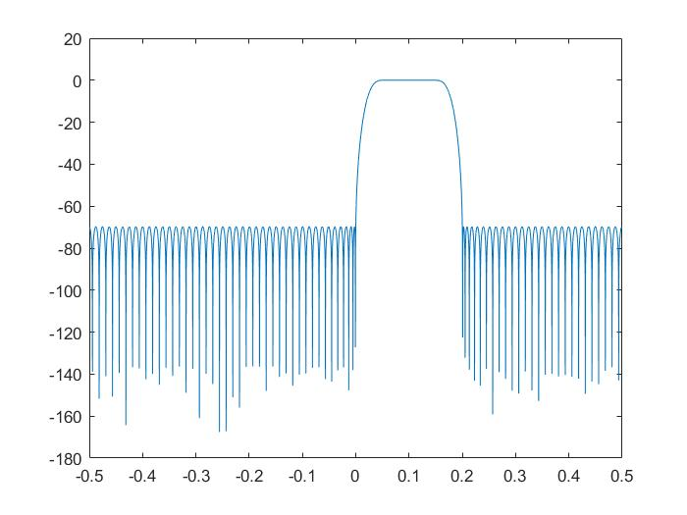
Filter 2
Nuisance Signals
SOI

Slide 5
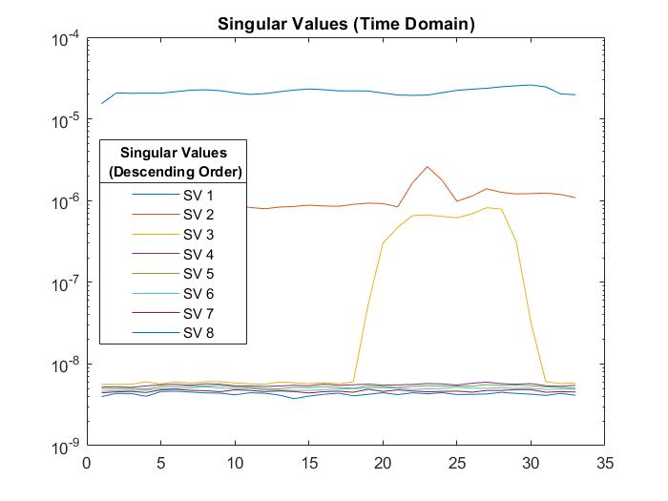
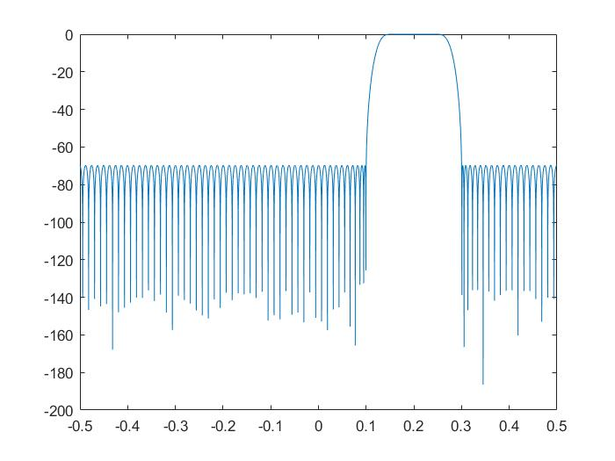
Filter 3
LMF

Slide 6
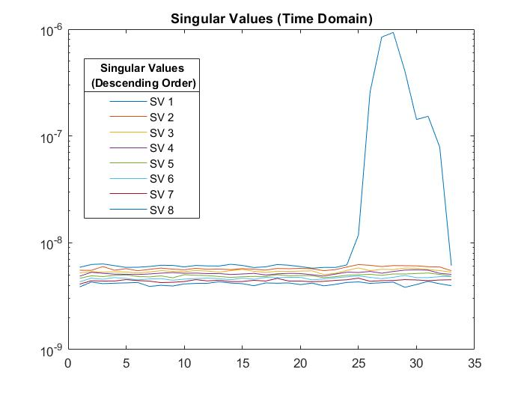
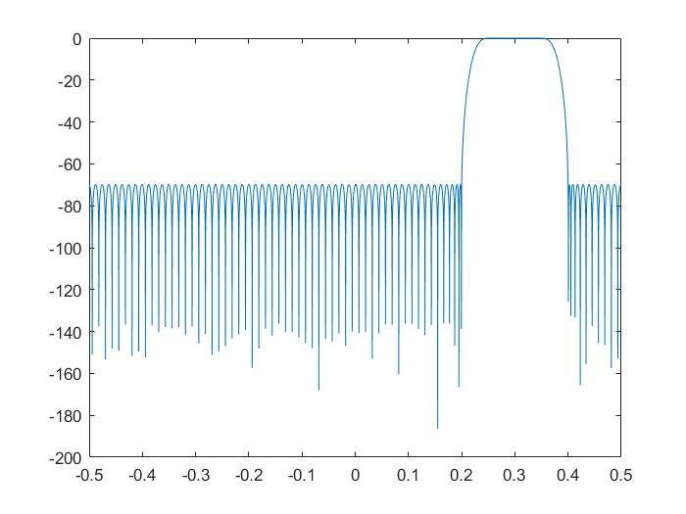
Filter 4

Slide 7
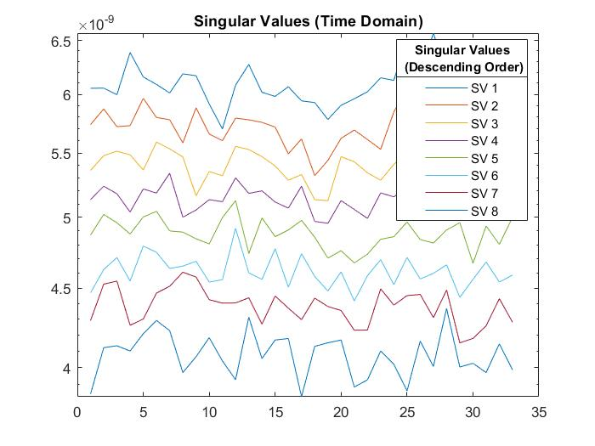
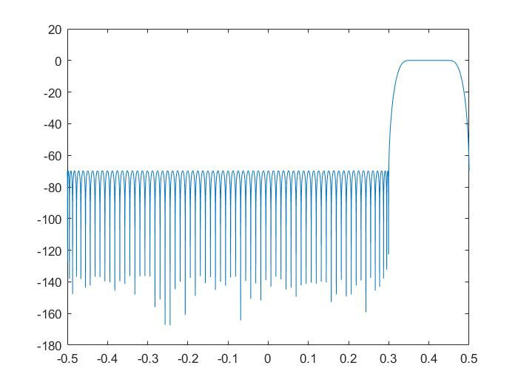
Filter 5

Slide 8
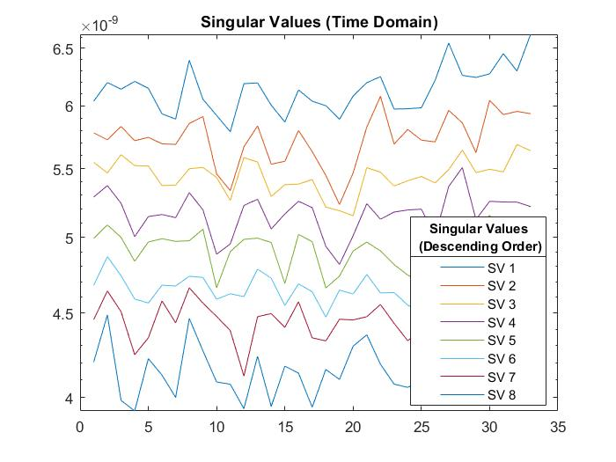
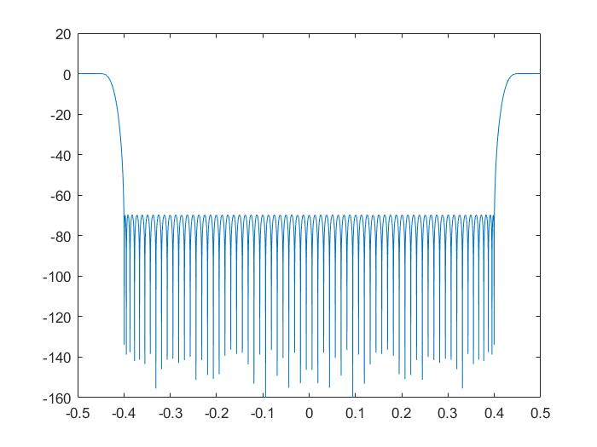
Filter 6

Slide 9
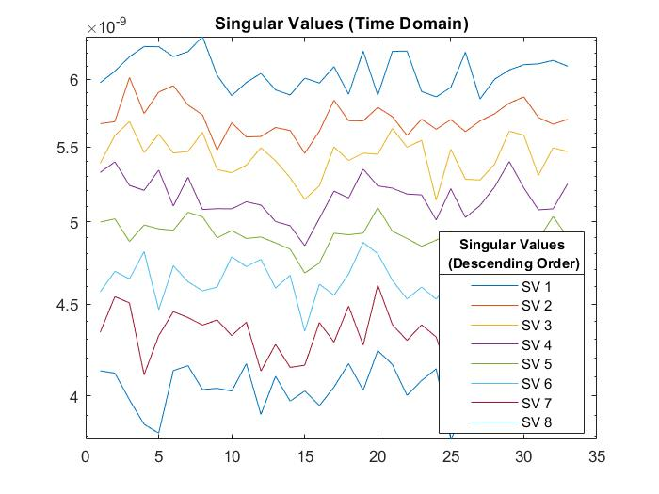
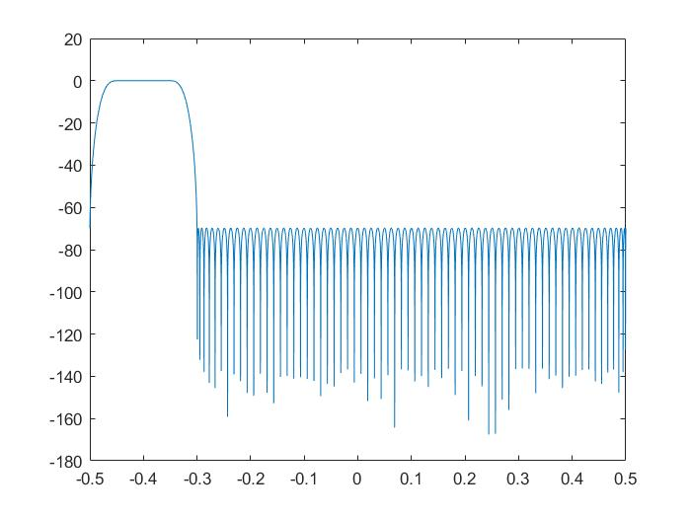
Filter 7

Slide 10
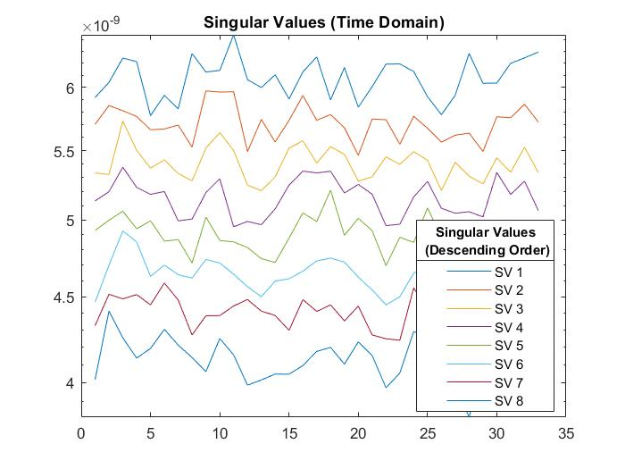
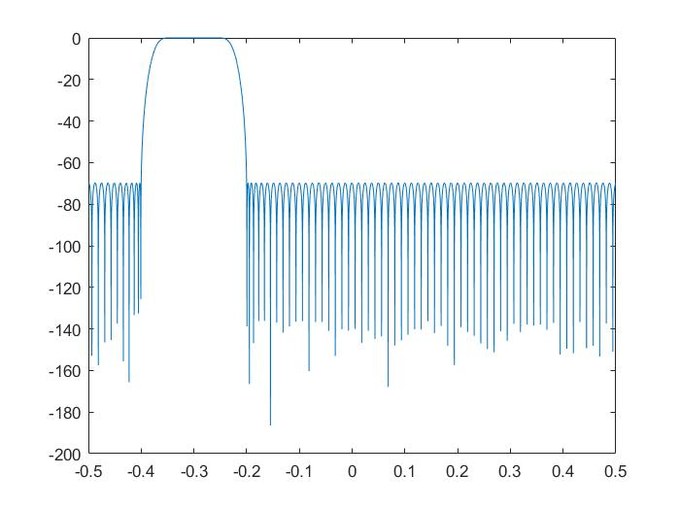
Filter 8

Slide 11
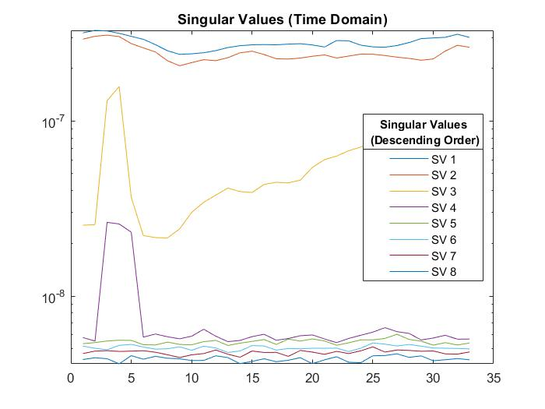
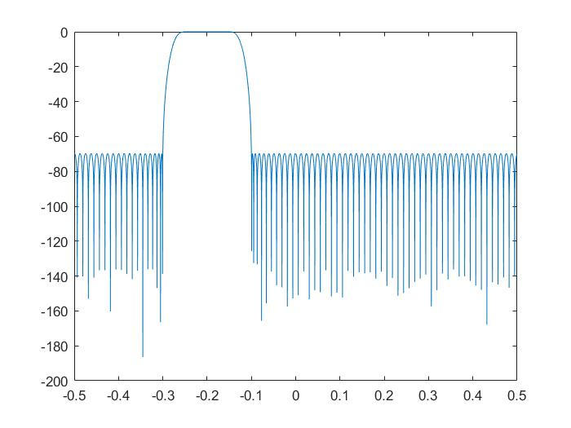
Filter 9

Slide 12
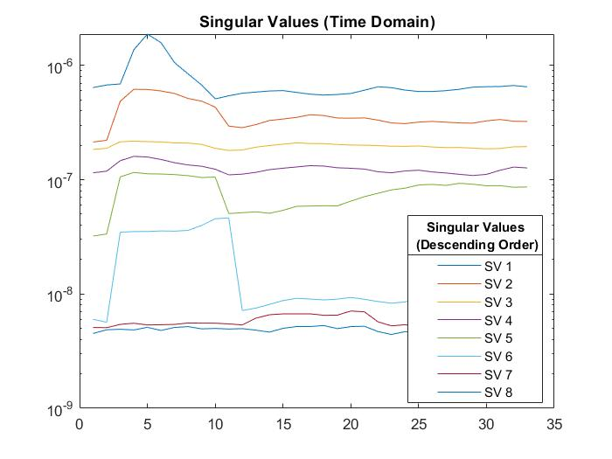
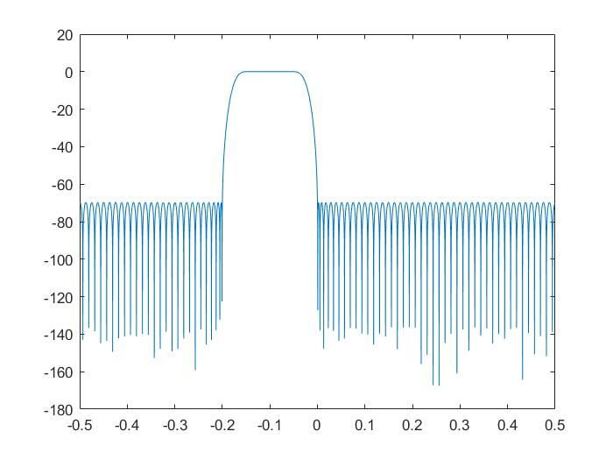
Filter 10

Slide 13
Summary
Results
SOI can be seen in the singular values of Filters 1 and 10
Filters 1, 2, 3, 9, and 10 show the singular values of the narrow band nuisance signals
Filters 3, 4, 8, 9, and 10 show the singular values of the LFM signal
Filters 5-8 is just random noise
The results line up with what is expected when looking at the waterfall plots and filter frequency response

